Slide 1
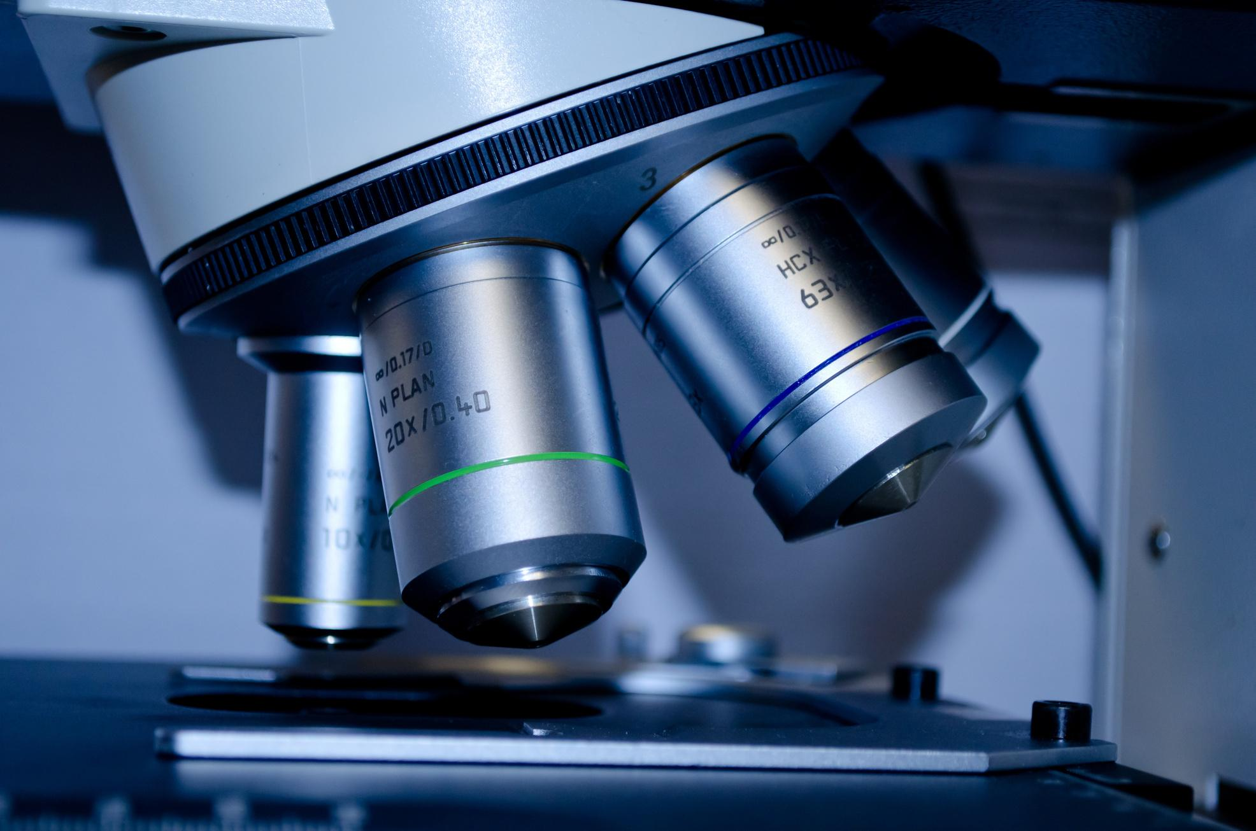
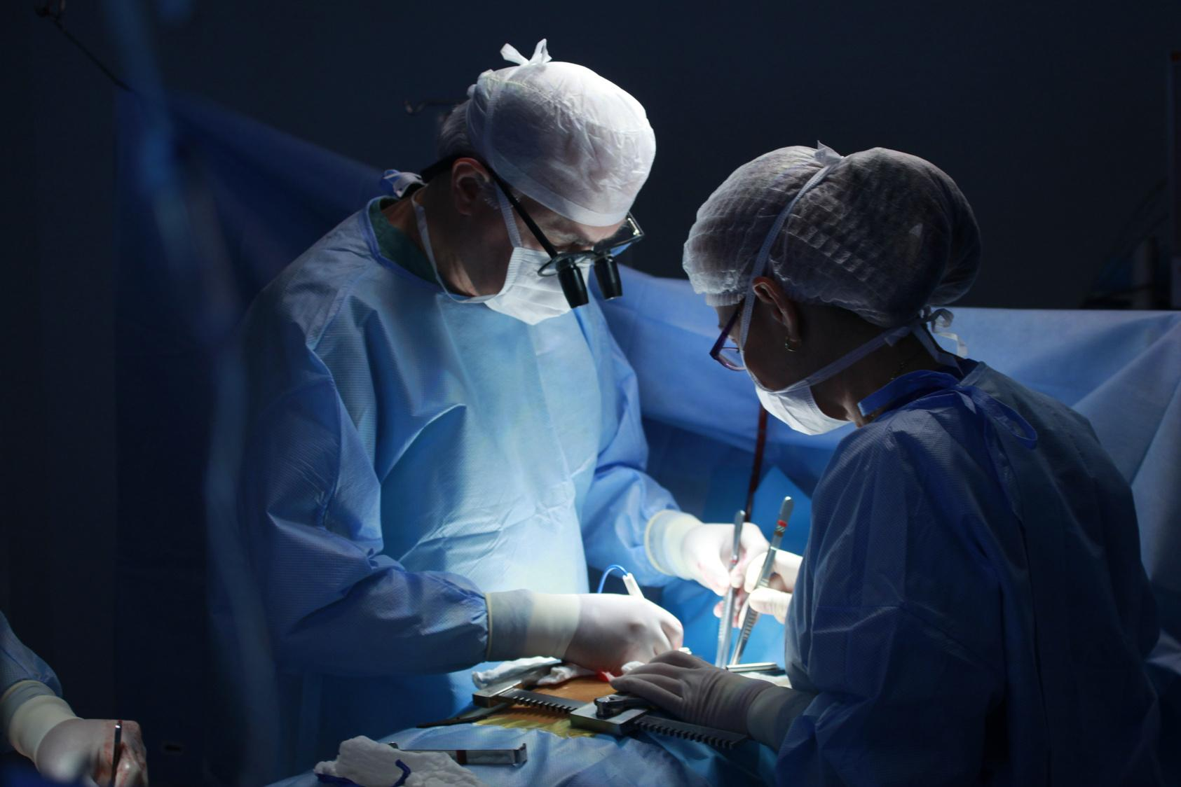
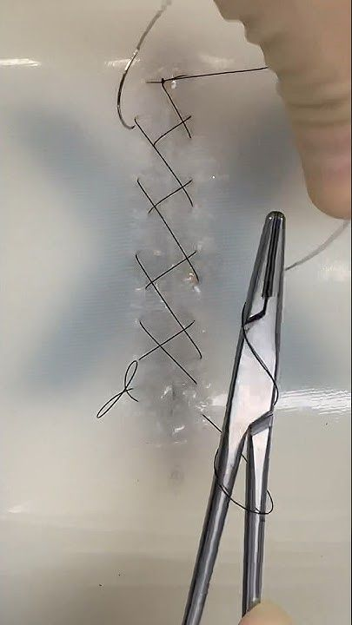
Suturing workshop

Slide 2
01.
Goals of suturing
02.
Suture materials and needles
Table of
Contents
03.
Wound Assessment & type of wound healing
04.
Suturing techniques
0.5
Removal

Slide 3
Goals of suturing
1. Wound edge apposition
2. Maintain hemostasis
3. Aid in wound healing
4. Avoid wound infection-cosmesis

Slide 4
Ideal Suture Characteristic
Inexpensive
Strong
Non allergenic
Easy to handle
Cause little or no inflammatory response
Cause minimal friction
Resists infection

Slide 5
Suture materials classification According to fate
1. Absorbable
2.Non absorbable-
Used for long term tissue closure like vessel anastomosis, laparotomy, herniafascialdefects closure.
.
Temporary closure until tissue heals.They lose most of their tensile strength over variable periods from a few weeks to several months.

Slide 6
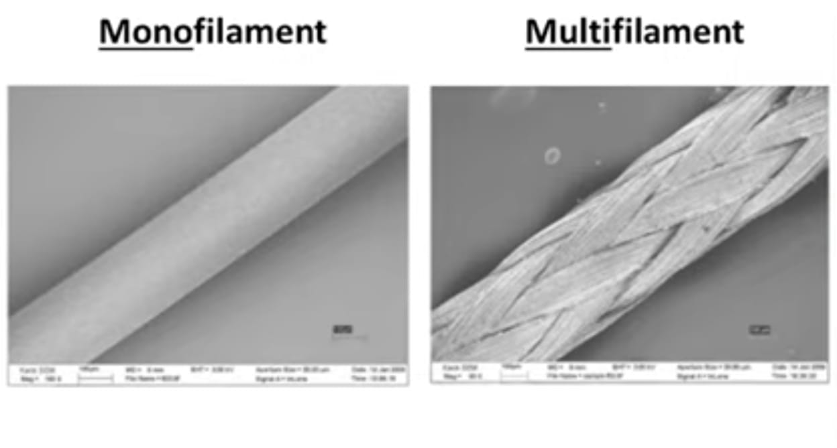
According to structure
1.Monofilament
2.Multifilament

Slide 7
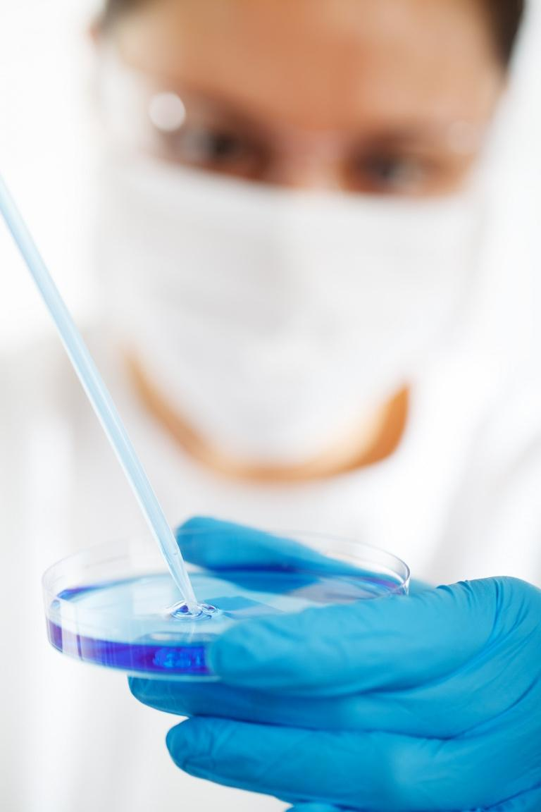
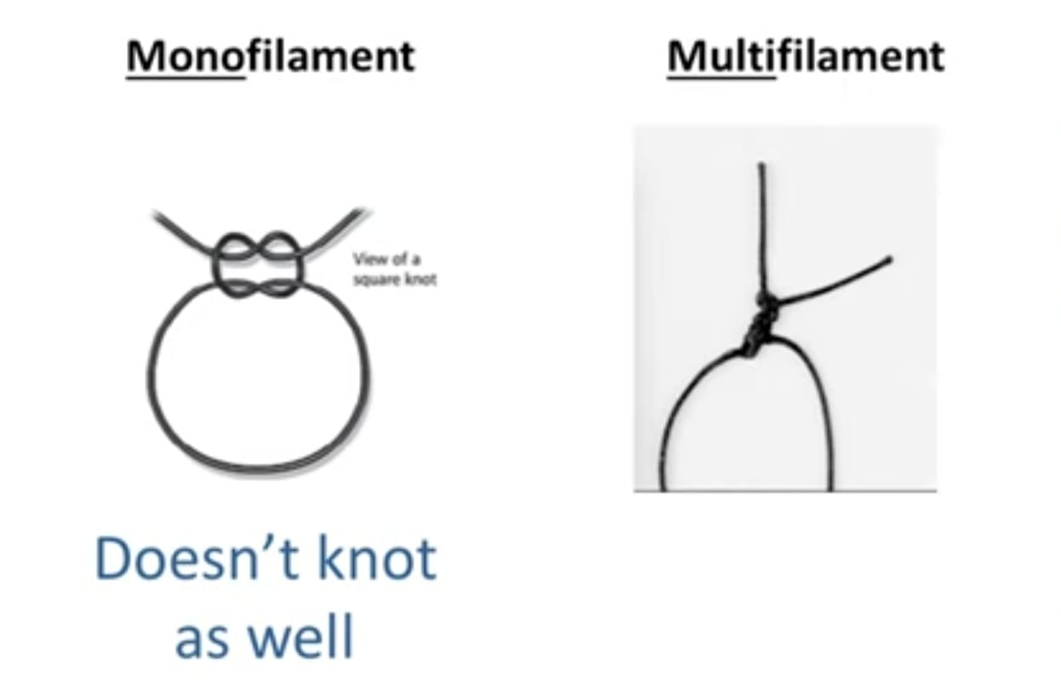
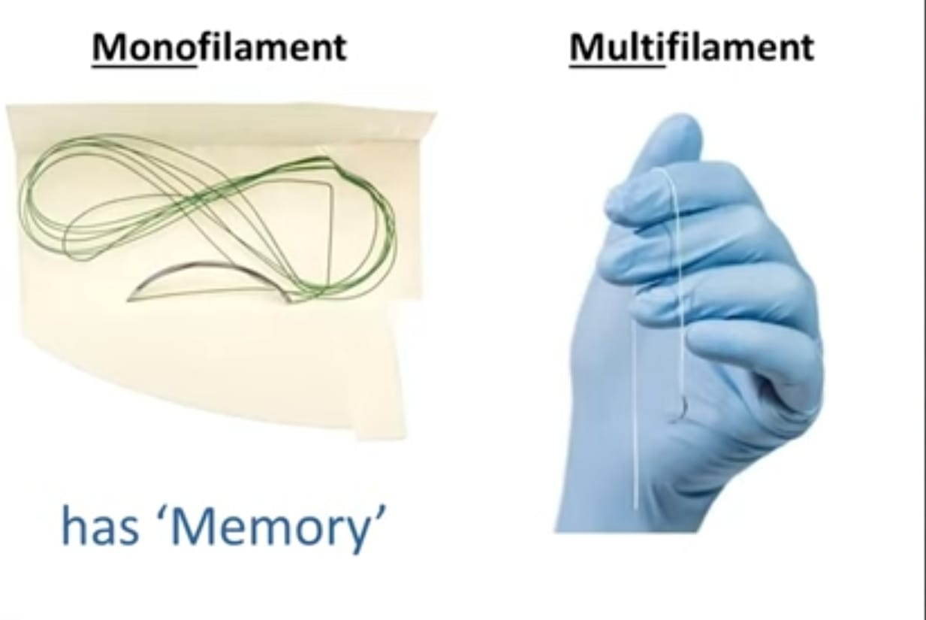
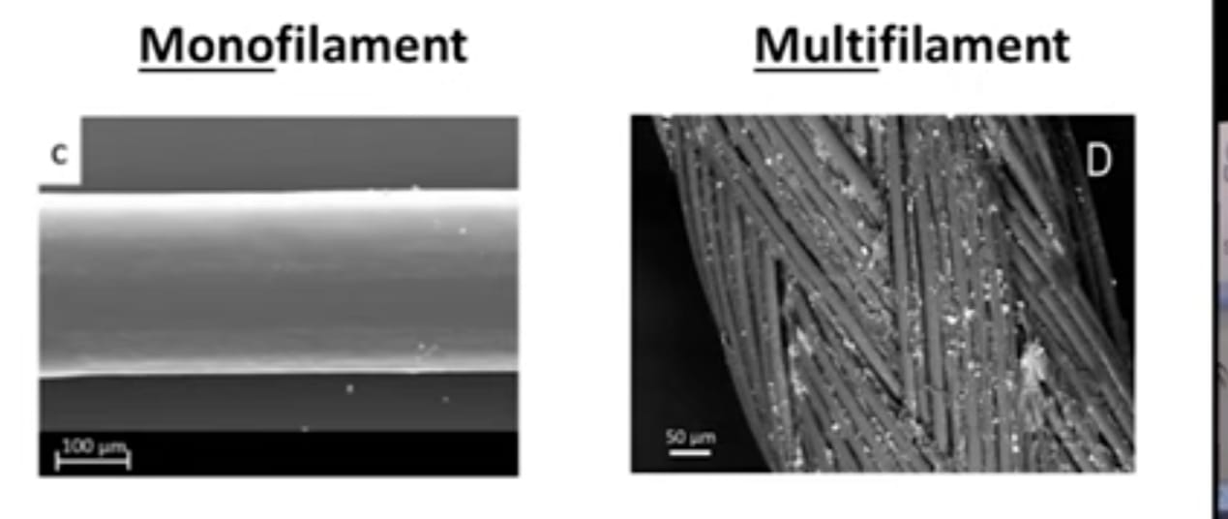

Slide 8
Monofilament
Multifilament
has more surface area and capillarity
increased infection risk
(so some are coated with antibiotics like vicryl plus )
-more friction ,less smooth passage
-less tensile strength
-better knot security because of less memory
single filament
less surface area-less infection risk-smooth tissue passage-higher tensile strength-more knots required because of memory

Slide 9
Absorbable
plain catgut
-chromic catgut
-PDS
Monofilament
Non absorbable
nylon
polypropylene

Slide 10
Absorbable
-vicryl
-polyglycolicacid
Multifilament
Non absorbable
-silk
-cotton

Slide 11
According to Source
1. Natural
2. Synthetic
3. Metallic

Slide 12

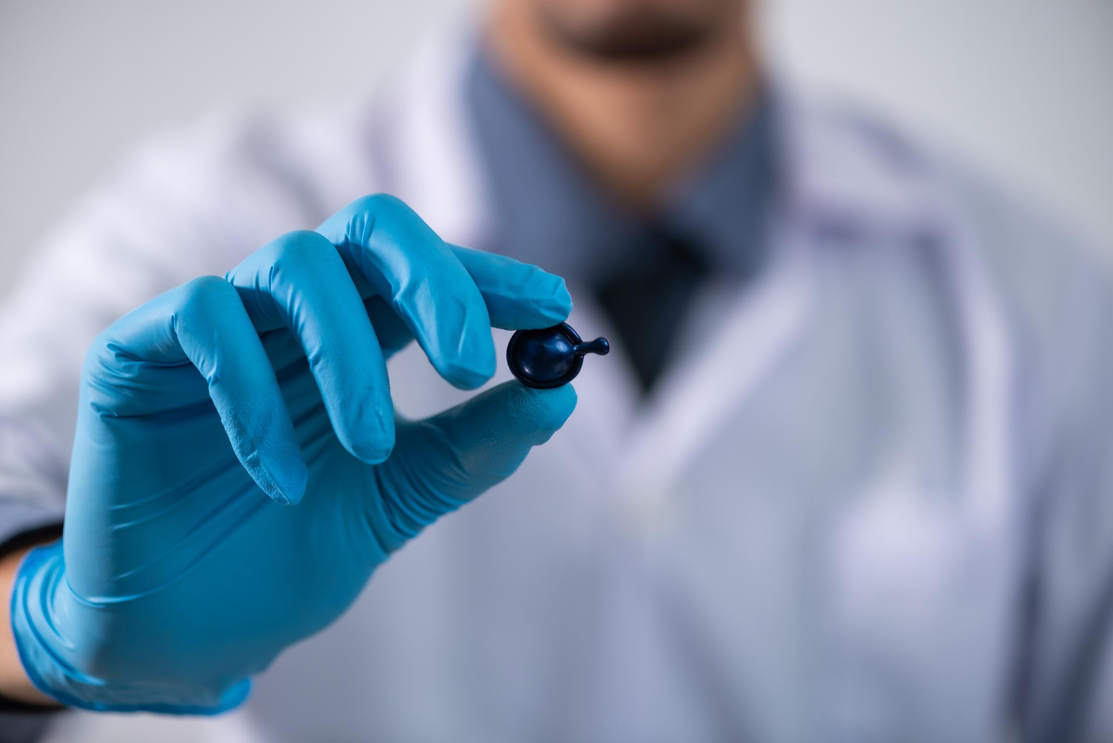
Natural
Absorbable
Non absorbable
-Plain catgut-from sheep submucosa/bovine serosa
-Chromic catgut-treated with chromium trioxide to strengthen and last longer before absorption
!
Silk

Slide 13
Synthetic
Absorbable
Non absorbable
Polyglactin910 (vicryl)
Polyglecaprone25 (monocryl)
polyglycolicacid (dexon)
Polydioxanone (PDS)
polyamide (Nylon)
Polypropylene (Prolene)

Slide 14
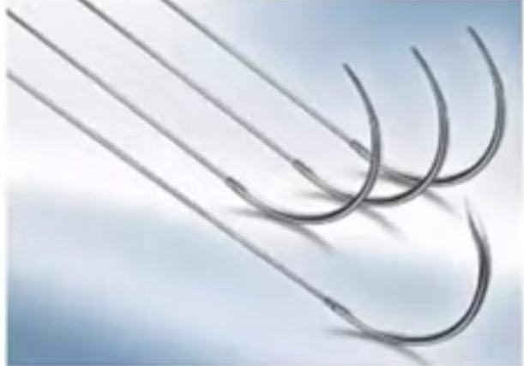
Metallic
Non absorbable
Stainless steel wire
polyamide (Nylon)
-polypropylene(Prolene)

Slide 15
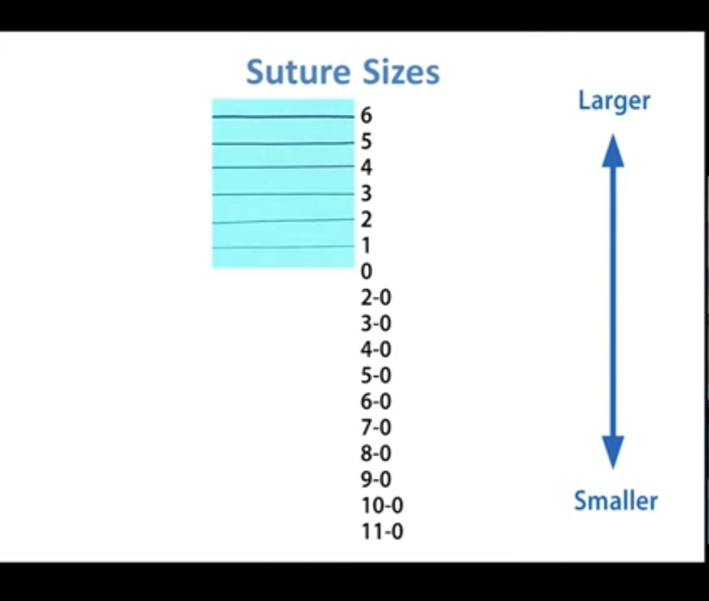

Slide 16
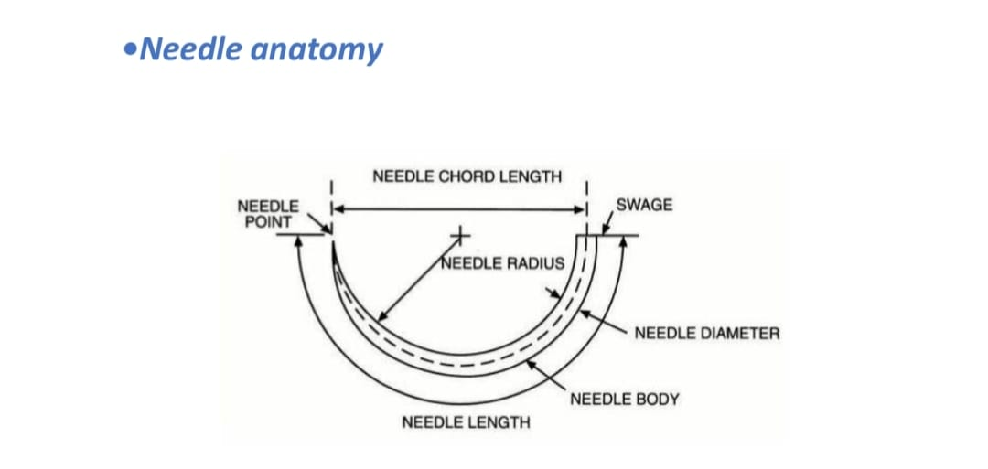
Suture needles
Needle anatomy
1. Needle chord length -straight line distance from tip to the end of needle
2. Needle length – distance along the needle itself from tip to the end of needle
3. Radius - distance from centre of circle to the body of needle
4. Diameter - thickness of needle

Slide 17
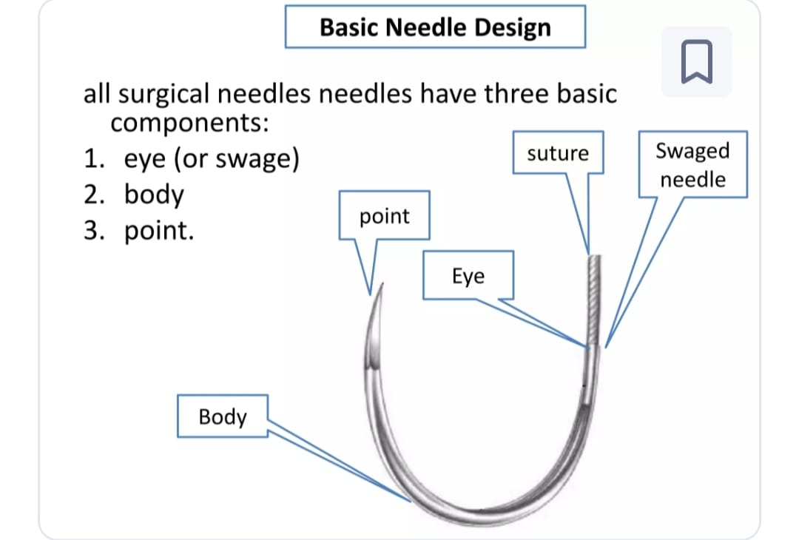
Basic needle design – eye, body, needle point

Slide 18
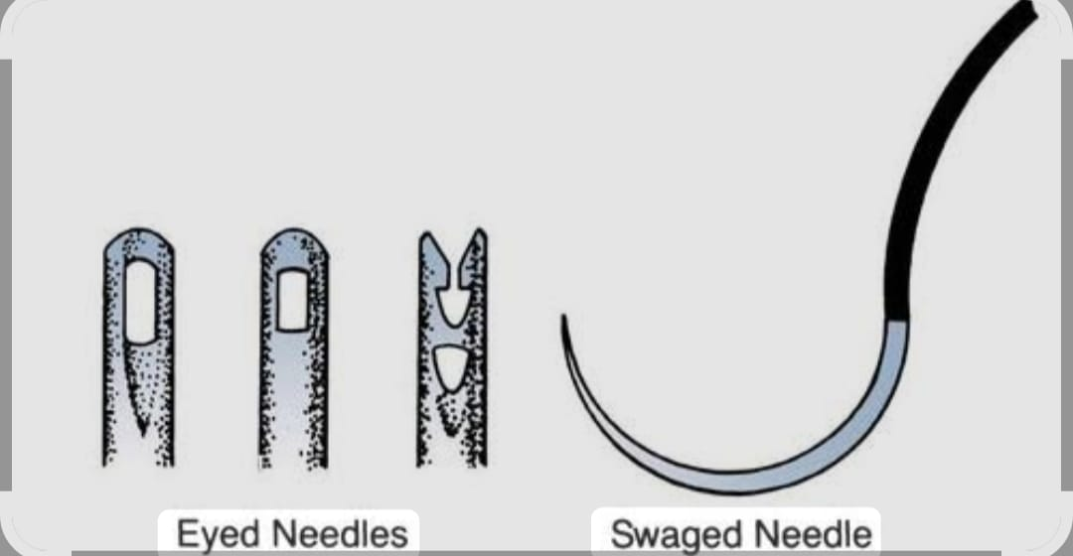
Eye or Swage
a. Eyed needle –economical, reusable, traumatic
b. Eyeless needle or swage – suture is directly attached to needle by manufacturer. Needle has smooth transition with suture, Atraumatic

Slide 19
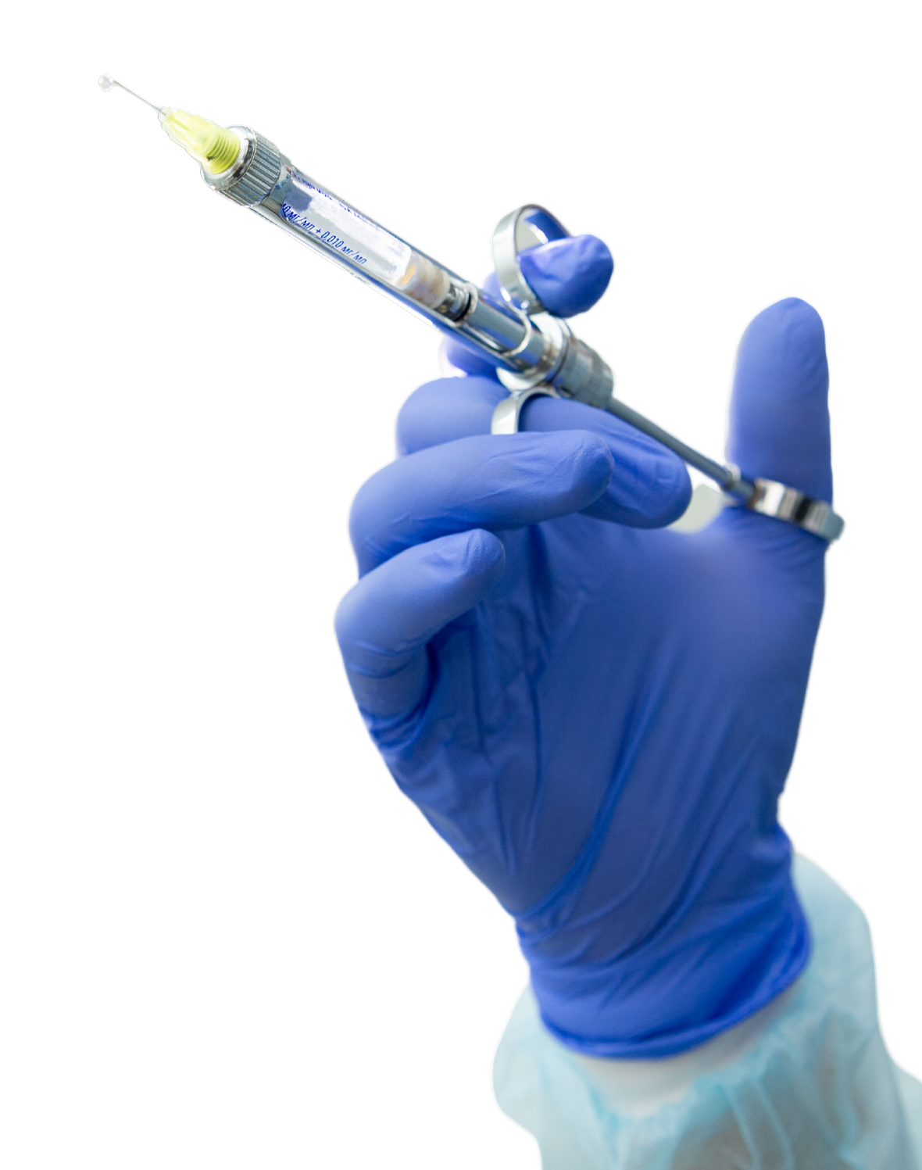
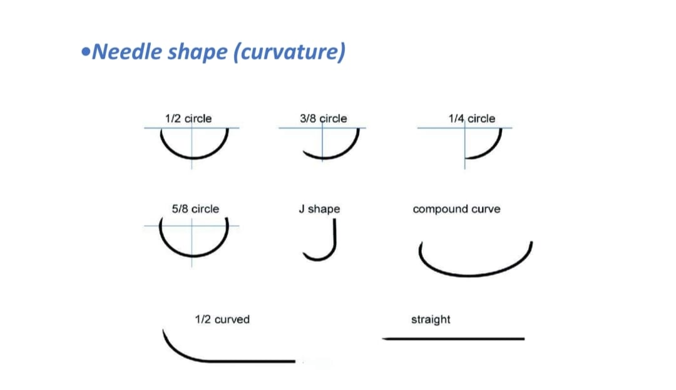
Needle body
straight body
Half curved
Curved body - 1/2 circle, 1/4 circle, 3/8 circle, 5/8 circle
Compound curve

Slide 20
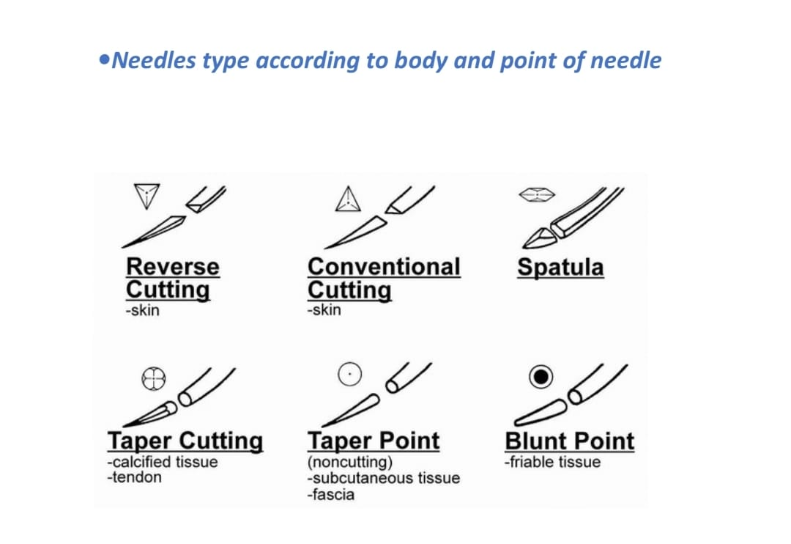
Needle point
Blunt point –friable tissue such as liver
Taper point –used to suture tissues that are easy to penetrate such as muscle and subcutaneous fat
Taper cut –like two needles in one with round body to reduce trauma to wound and cutting tip to improve penetration, used in calcified tissue, tendon
Reverse cutting – triangle shape body with apex in outer side of the curve . Used in skin closure
Conventional cutting - same like reverse cutting except apex in inner side of curve
Spatula –fine needles with sharp cutting edge, square or flat body, used in oculoplastic procedures.

Slide 21
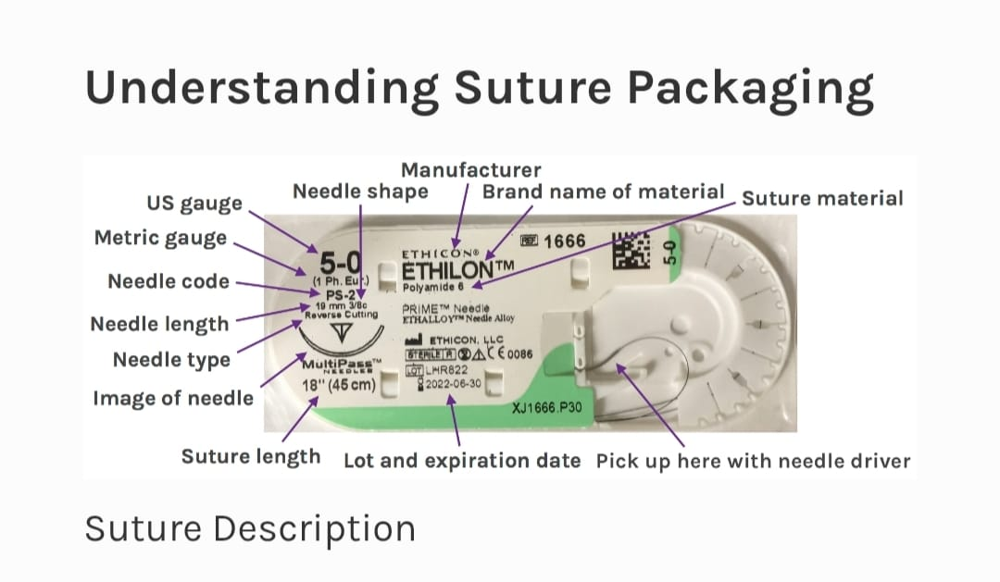
Nylon (Ethilon)-70 % TS maintained after 10 years .Temporary use in skin closurePermanent use in Laparotomy closure

Slide 22
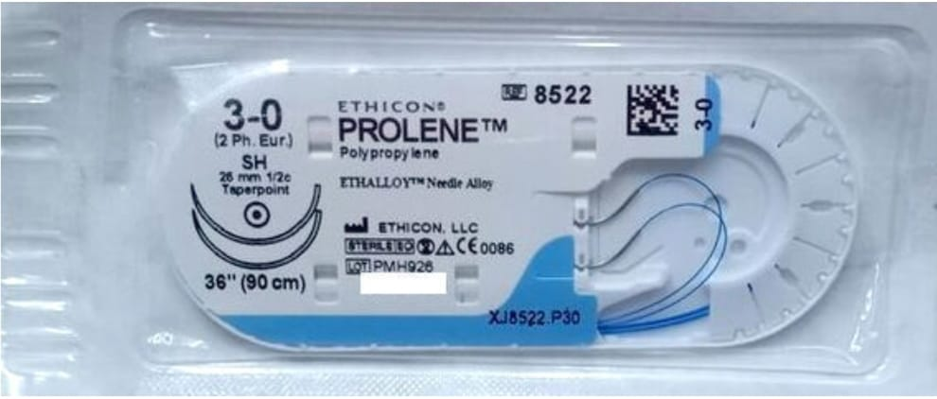
Remains encapsulated in tissues. Used in cardiovascular surgery and wall closure Hernioplasty

Slide 23
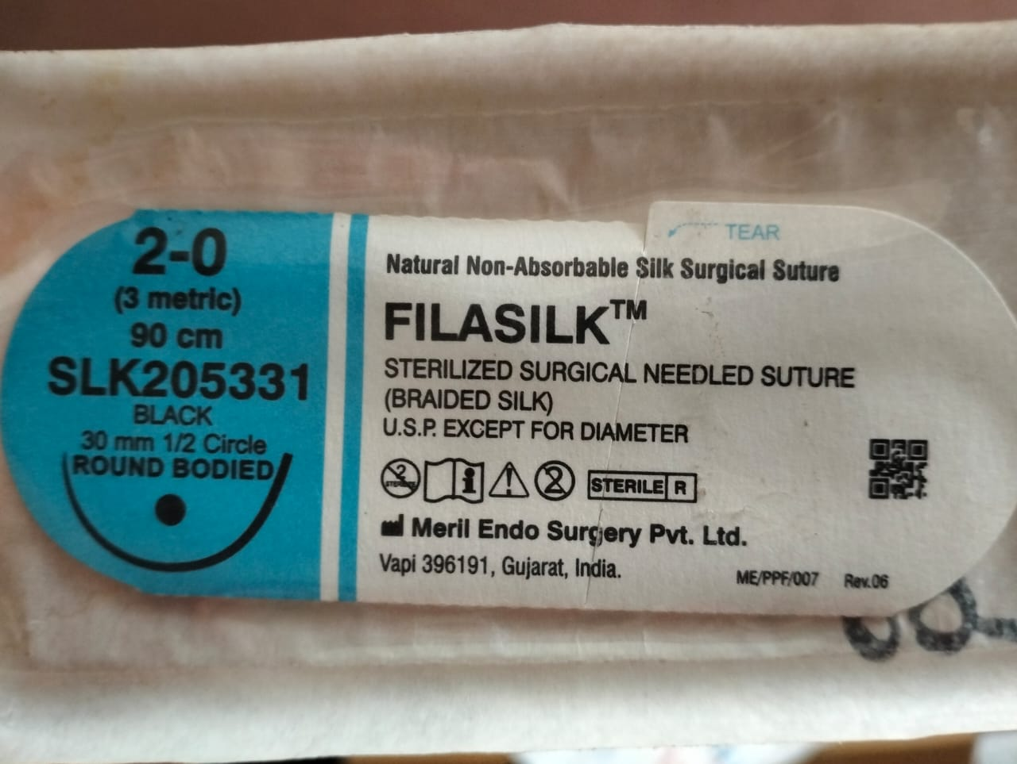
Silk – 80 % TS lost by 60 months. Tissue reaction high, not recommended. Securing drains.

Slide 24
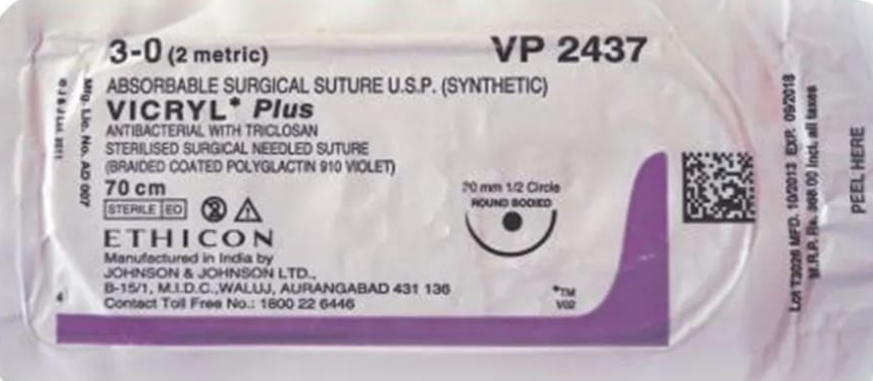
Vicryl – 65-70 percent tensile strength maintained after 14 days. Absorbed in 2 months. Used in deep tissues ,fascia ,muscle

Slide 25
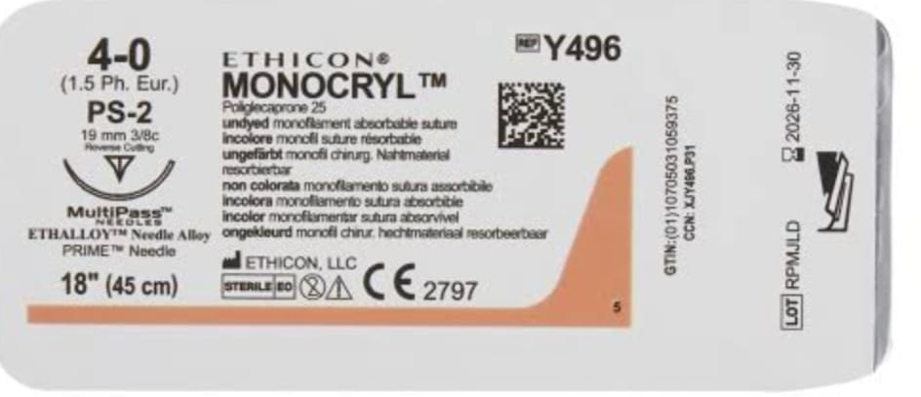
Monocryl –60% tensile strength maintained after 1 week. Absorbed in 120 days.used in delicate subcuticular sutures

Slide 26
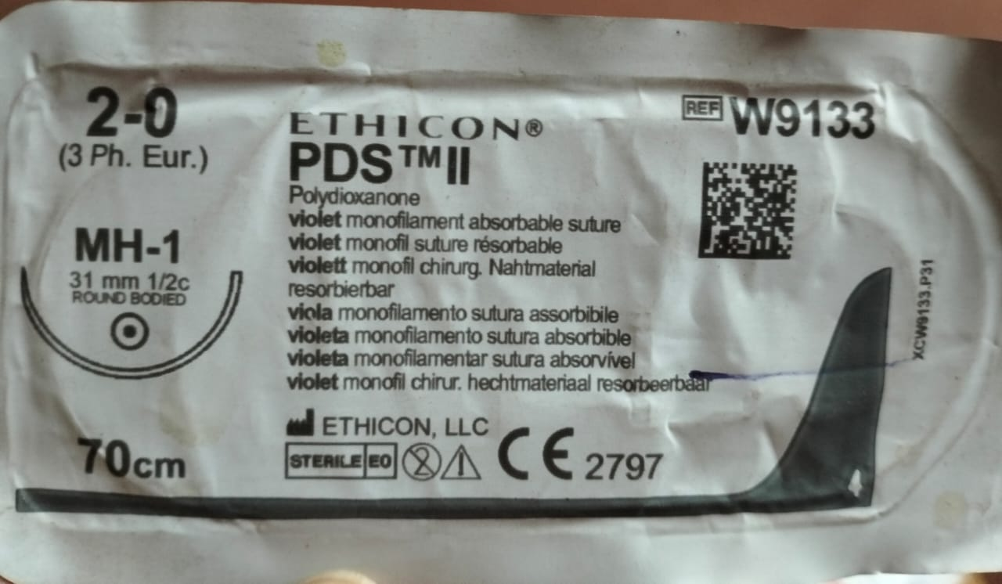
PDS-70% TS maintained.Absorbed in 7-8months.

Slide 27
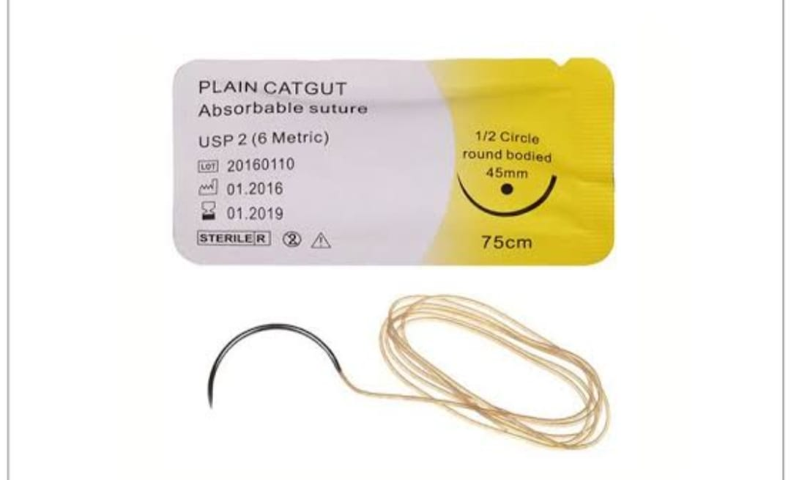
Plain gut -75% TS maintained at 7 days,completely absorbed in 70 days.used in oral mucosa,nasal cavities

Slide 28
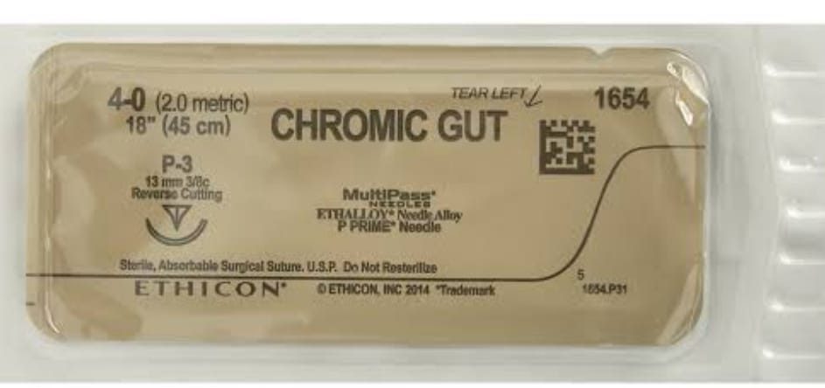
Chromic gut -75% TS at 14 days,completely absorbed within 90days

Slide 29
Thank you!

Slide 30
Your Project

